Slide 1
Remote Method Invocation
RMI is an API that allows an object to invoke a method on an object that exists in another address space, which could be on the same machine or on a remote machine.
RMI creates a public remote server object that enables client and server-side communications through simple method calls on the server object.
It is a mechanism that allows an object residing in one system (JVM) to access/invoke an object running on another JVM.
RMI is used to build distributed applications
It is provided in the package java. rmi.
The RMI provides remote communication between the applications using two objects stub and skeleton.

Slide 2
In an RMI application, we write two programs, a server program (resides on the server) and a client program (resides on the client).
Inside the server program, a remote object is created and reference of that object is made available for the client (using the registry).
The client program requests the remote objects on the server and tries to invoke its methods.

Slide 3
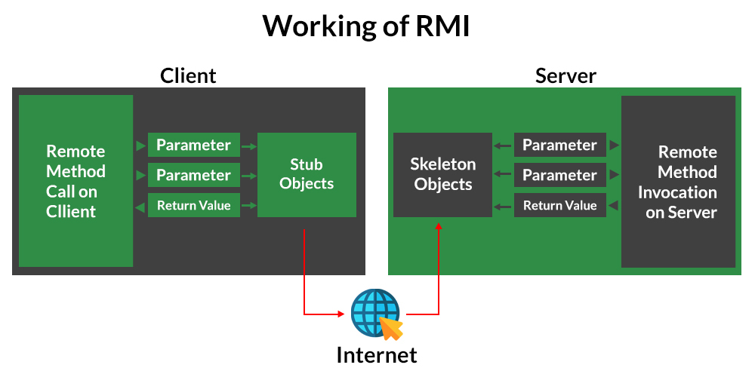

Slide 4
Stub
The stub is an object, acts as a gateway for the client side.
All the outgoing requests are routed through it.
It resides at the client side and represents the remote object.
When the caller invokes method on the stub object, it does the following tasks:
It initiates a connection with remote Virtual Machine (JVM),
It writes and transmits (marshals) the parameters to the remote Virtual Machine (JVM),
It waits for the result
It reads (unmarshals) the return value or exception,
It finally, returns the value to the caller.

Slide 5
Skeleton
The skeleton is an object, acts as a gateway for the server side object.
All the incoming requests are routed through it.
When the skeleton receives the incoming request, it does the following tasks:
It reads the parameter for the remote method
It invokes the method on the actual remote object, and
It writes and transmits (marshals) the result to the caller.

Slide 6
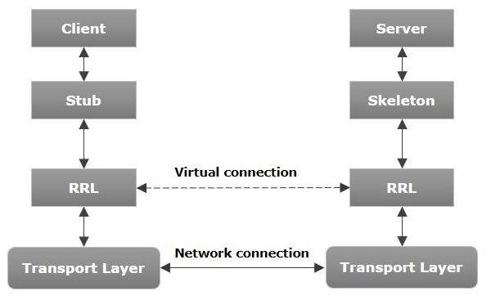
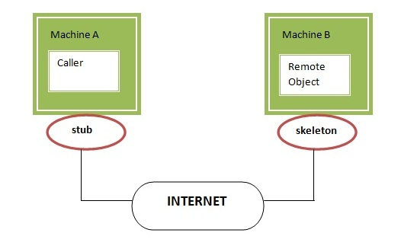

Slide 7
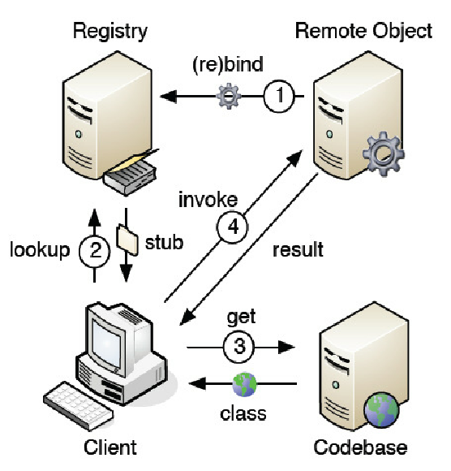
RMI Registry
The RMI registry is a simple server-side name server(remote interface) that allows remote clients to get a reference to a remote object.

Slide 8
Java.rmi.Naming class contains a method to bind, unbind or rebind names with a remote object present at the remote registry.
This class is also used to get the reference of the object present at remote registries or the list of name associated with this registry.
bind() - A remote object can be associated with a name
list() - Used to get the list of the names associated with the registry
lookup() - looks for the reference of the remote object to which this name is associated
rebind() - rebinds this name with the associated remote object
unbind() - unbinds this name with the associated remote object
Note: java.rmi package: Remote Method Invocation (RMI) has been deprecated in Java 9 and later versions, in favor of other remote communication mechanisms like web services or Remote Procedure Calls (RPC).

Slide 9
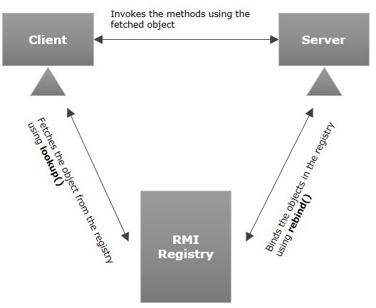

Slide 10
Steps to implement Interface :
Defining a remote interface
Implementing the remote interface
Creating Stub and Skeleton objects from the implementation class using rmic (RMI compiler)
Start the rmiregistry
Create and execute the server application program
Create and execute the client application program.

Slide 11
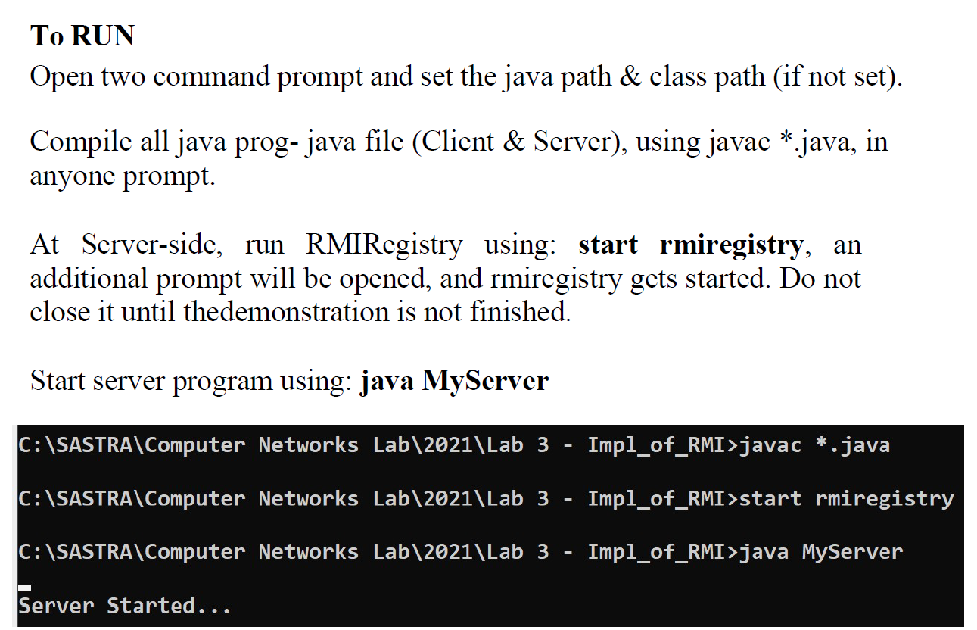

Slide 12
